Slide 1

DR. BABASAHEB AMBEDKAR MARATHWADA
UNIVERSITY, AURANGABAD
Department of Computer Science and Information Technology
(2022-2023)
SEMINAR ON
“Cluster Computing”
Master of Science (Information Technology)
(SEM 4)
GUIDANCE BY
Dr. C. Namrata Mahender
SUBMITTED BY
Miss. Manasi Manohar Sapkale

Slide 2
CONTENT
Introduction
Types of Cluster Computing –
High Availability
Load Balancing Cluster.
Parallel/Distributed Processing Clusters.
Advantages of Cluster Computing
Cluster Component
Conclusion
Reference

Slide 3
INTRODUCTION
Cluster computing defines several computers linked on a network and implemented like an individual entity. Each computer that is linked to the network is known as a node.
Cluster computing provides solutions to solve difficult problems by providing faster computational speed, and enhanced data integrity.
The connected computers implement operations all together thus generating the impression like a single system. This procedure is defined as the transparency of the system.
Cluster are typically use for HA and HPC to provide greater computational power than the single computer can provide.

Slide 4
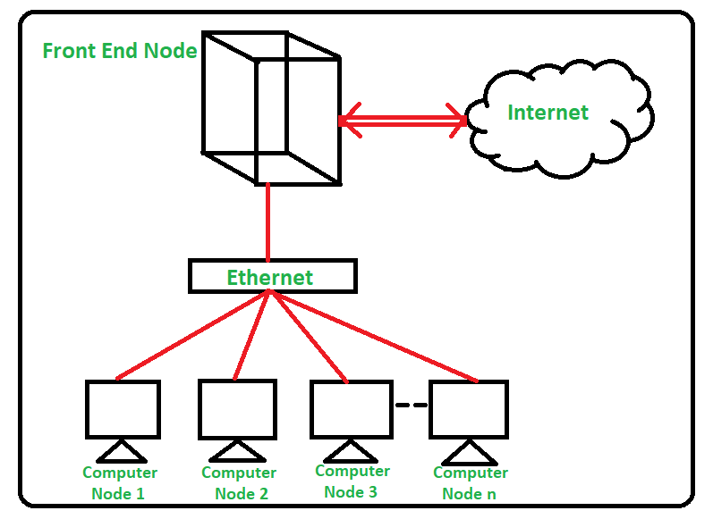
Figure 1: CLUSTER COMPUTING

Slide 5
TYPES-
1. High Availability (HA)
These cluster models generate the availability of services and resources in an uninterrupted technique using the system’s implicit redundancy.
The basic term of Cluster is that if a node declines, then applications and services can be made available to different nodes. These methods of clusters deliver as the element for critical missions, mails, documents, and application servers.
High-availability clusters implementation are best for mission-critical applications or database.

Slide 6
Figure 2: HA
E-mail
Server
E-mail
Server
E-mail
Server
Load balancer
primary
Load balancer
Backup

Slide 7
2. Load Balancing Clusters
This cluster allocates all the incoming traffic/requests for resources from nodes that run the equal programs and machines.
In this cluster model, some nodes are answerable for tracking orders, and if a node declines, therefore the requests are distributed amongst all the nodes available. Such a solution is generally used on web server farms.

Slide 8
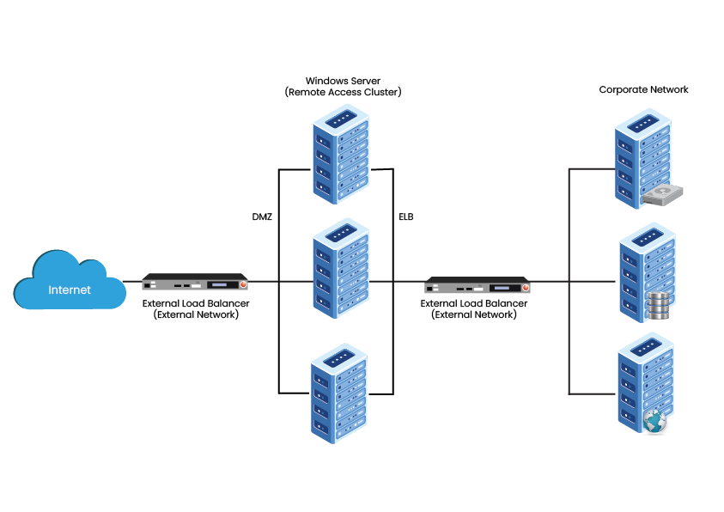
Figure 2:Load balancing

Slide 9
3. Distributed & Parallel Processing Clusters
This cluster model boosts availability and implementation for applications that have huge computational tasks.
A large computational task has been divided into smaller tasks and distributed across the stations. Such clusters are generally used for numerical computing or financial analysis that needs high processing power.

Slide 10
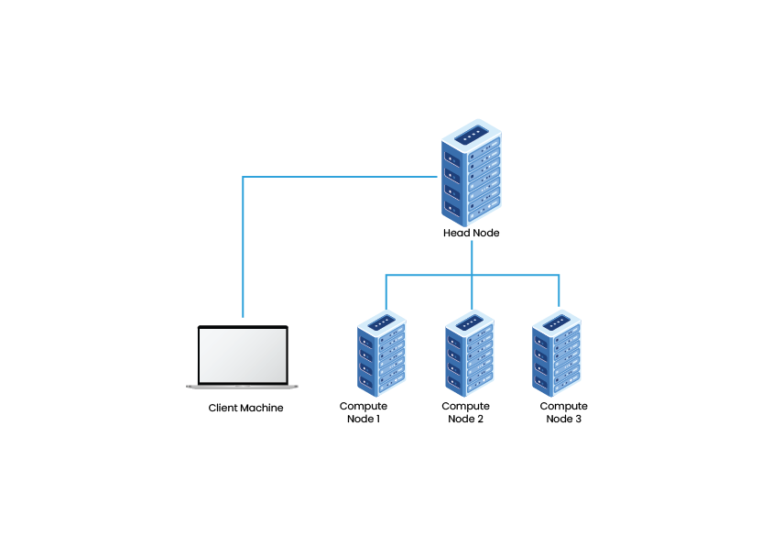
Figure 3:Distributed & Parallel Processing Clusters

Slide 11
ADVANTAGES
Cost-Effectiveness − Cluster computing is considered to be much more cost-effective. These computing systems provide boosted implementation concerning the mainframe computer devices.
Processing Speed − The processing speed of cluster computing is validated with that of the mainframe systems and other supercomputers demonstrate around the globe.
Increased Resource Availability − Availability plays an important role in cluster computing systems. Failure of some connected active nodes can be simply transformed onto different active nodes on the server, providing high availability.
Improved Flexibility − In cluster computing, better description can be updated and improved by inserting unique nodes into the current server.

Slide 12
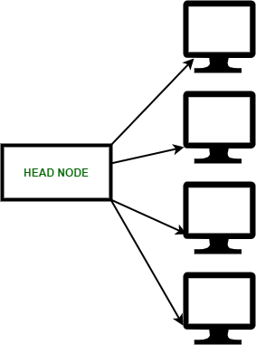
CLUSTER COMPONENT
Few important cluster component are:
Cluster Nodes
Cluster Network
Network Characterization

Slide 13
CONCLUSION
Cluster computing is cost-effective, expandable, and ensures the high availability of resources. They can be either loosely or tightly coupled to bind them together so that they can work as a single system to achieve the task.
Clusters can be created based on the requirements (high performance, high availability, or load balancing). Which makes it easier for the users to create it based on the system's needs. Also, it is possible to achieve load balancing along with high availability.

Slide 14
REFERENCE
https://www.google.com
https://www.geeksforgeeks.org/an-overview-of-cluster-computing/

Slide 15
THANK YOU

